Slide 1

Macroeconomics II
Lecture 04 (February 2023)
Growth in reality:
The cases of the US, Japan, South Korea and China
1
Notes:
1

Slide 2
Growth is not even
Accumulation is unequal
Let's look at the historical experience

Slide 3
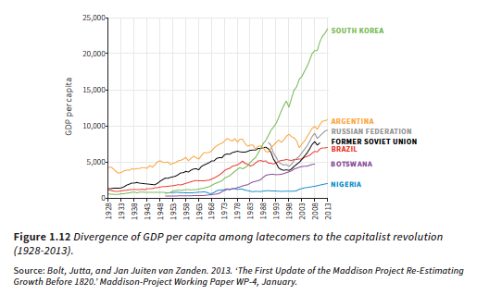
Divergence among latecomers
3
Notes:
3

Slide 4
But the past teaches how the divergence and convergence were generated

Slide 5
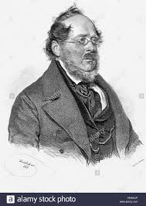
List and th industrial protection in Germany
Friedrich List, German economist:
accused Britain of “kicking off the ladder” (1841) and trying to impose free trade against Germany's protection of infant industries

Slide 6
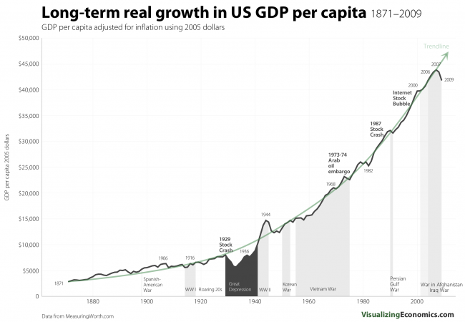
The USA success

Slide 7
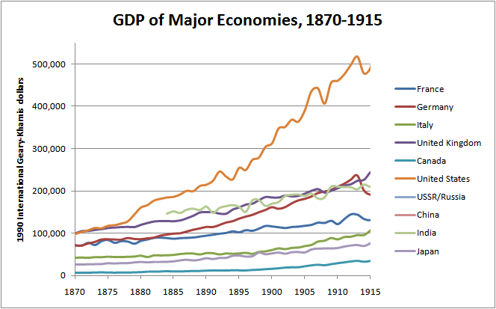
The dominant economy by the end of the 19th century

Slide 8

Taylorism and Fordism

Slide 9
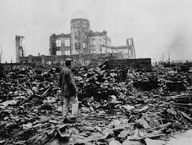
Japan, since the 2nd World War
MITI (industry ministry)
Creation of a National system of innovation
Examples: investment in cars and consumer electronics
Externatilities on other industries

Slide 10

The case of Toyota
Toyota was a textile manufacturer, moved into the car business by 1933
The Japanese government kicked out Ford and General Motors in 1939
Public funds bailed out Toyota in 1949
The largest world manufacturer today

Slide 11
Japan and Argentina
1950s: Argentina's GDP per capita was 3 times that of Japan
Today:
  Argentina: 14,400 dollars
  Japan: 38,400 dollars
Simon Kuznets: there are four types of economies, developed, underdeveloped, Japan and Argentina...

Slide 12

The example of Nokia
1960s Wood exploitation (radio communication among workers)
1970s innovation in semi-conductors
17 years of research for the domination of the world market until 2003 (half of world sales) + public financing
2007 iphone (from 5% share in the world market)
Looses 90%, sold to Microsoft
Back with 5G?

Slide 13
South Korea
South Korea: 1960s and 1970s: total control on banking system and managed the industrial development (eg, Posco, steel maker)
Control of foreign capital movements
Promotion of big industrial conglomerates
National system of innovation providing for knowledge and incentives

Slide 14
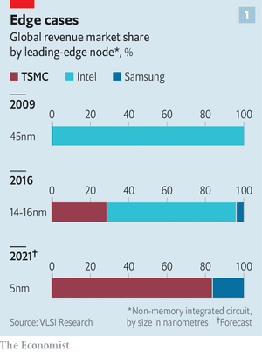
South Korea and Taywan: competition for semiconductors

Slide 15
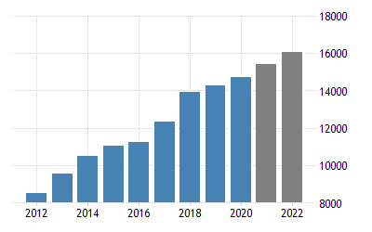
China, the factory of the world
(GDP growth, doubling in ten years)

Slide 16
The Chinese “model”
Control of the banking system, of transfers of capital and investment
Private firms, but under effective public control
More billionaires than in the USA

Slide 17
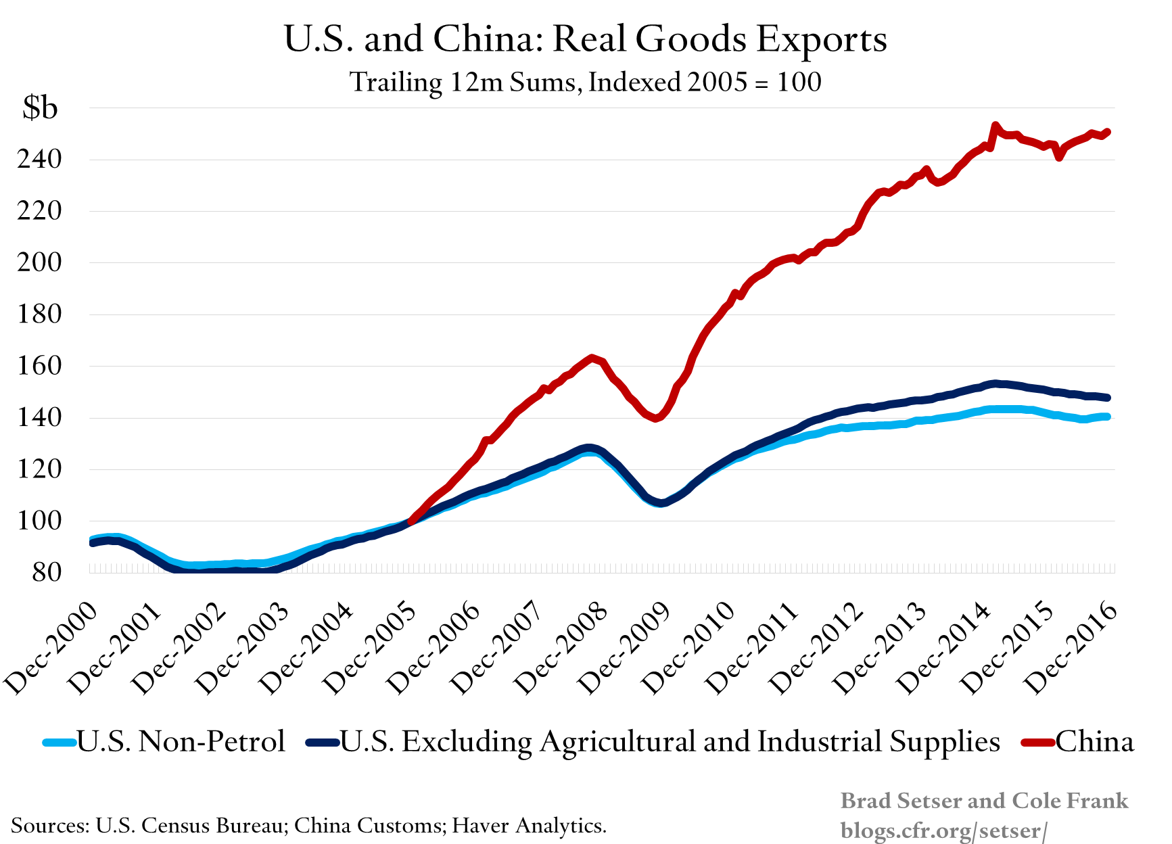
Chinese and US exports

Slide 18
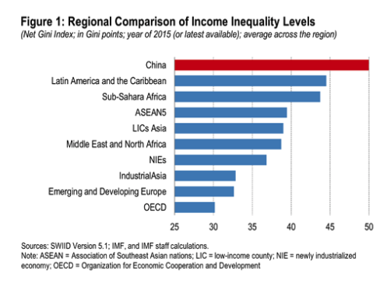
Regional inequalities

Slide 19
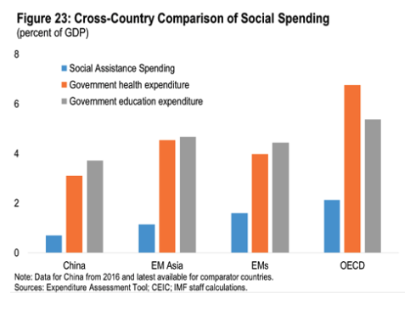
Differences in social spending

Slide 20
EU vs China (trade and industrial policy)
China joined the WTO in December 2001
Trade with the EU grew very fast, initially with exports of China being light industries – greatly affecting exports of EU peripherical economies to the EU, as they exported the same as China, but not as competitively.
Since EU countries that are members of the Euro mechanism have no independent monetary policy, they could not devalue the currency, and devalued wages instead.
Trade deficit of EU vs China increased sharply, but affected mostly peripherical economies, which to compete against China for the EU market, not so much German and France, which were exporting technology intensive products

